Slide 1
Breathe out… 1… 2… 3… 4…
Breathe…
Breathe in… 1… 2… 3… 4…
Breathe in… 1… 2… 3… 4…
Breathe out… 1… 2… 3… 4…

Slide 2
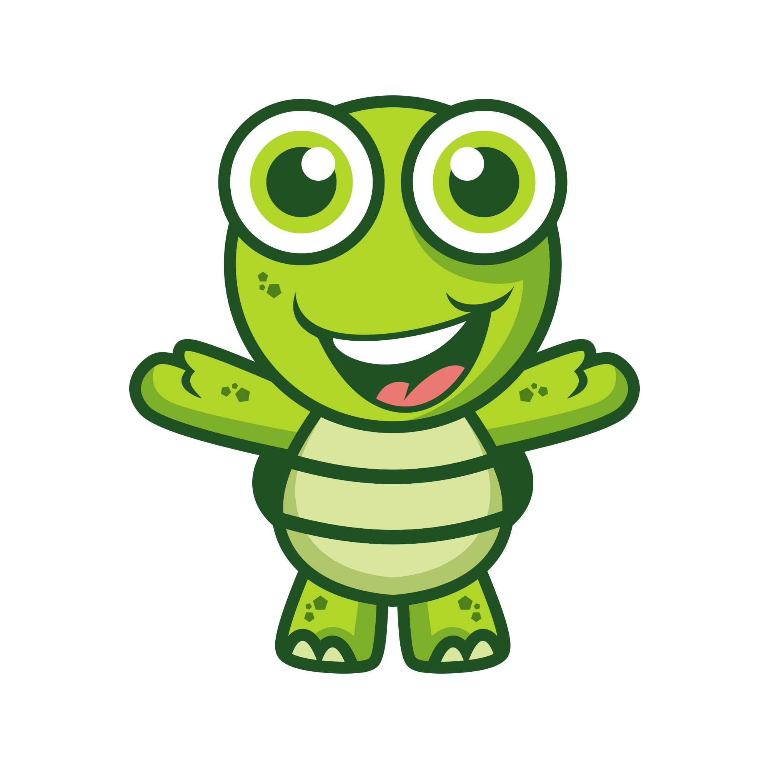
Relaxation Menu
Relax in the bean bag
Pretend to be a Turtle! Go into your shell
Slowly count to 10
Squeeze my hand 7 times
Take 5 square breaths

Slide 3
HAPPY
EXCITED
SAD
SCARED

